Slide 1
Bike Rental Analysis Report
Radhika Rathod
25-03-2026

Slide 2
Problem Statement / objectives
Data overview
Data cleaning & preparation
Key analysis & approach
Dashboard & Visualization
Key insights
Business impact
Challenges & learning
Future improvements
Conclusion

Slide 3
Overview
Objective
“To analyse factors affecting bike rental demand and identify patterns to improve business decisions.”
Dataset overview
Total records : 1000
Columns : temp, humidity, windspeed, customer counts etc
Time period covered : Jan – Feb 2011
Data cleaning (Excel) :
Removed blanks/missing values
Checked duplicates
Formatted date & time
Created new columns like day , rental by hours, weather situation.
Excel Technique Used :
Pivot Tables
Charts(Line, bar, heatmap)
Conditional formatting
Correlation analysis
Formulas

Slide 4
Key analysis
Correlation between dataset
Bike rental demand is slightly influenced by temperature (positive correlation ~0.23) and negatively impacted by humidity (~ -0.25), indicating users prefer comfortable and less humid weather. Windspeed has minimal effect on demand. Additionally, humidity and windspeed show a moderate inverse relationship, reflecting environmental interaction.
People prefer riding in comfortable weather
High humidity = uncomfortable → fewer rides
Wind doesn’t strongly affect rental decisions
 | temp | hum | windspeed | Cnt
temp | 1
hum | 0.0807201 | 1
windspeed | 0.1226253 | -0.38555 | 1
cnt | 0.2292916 | -0.254353 | 0.1039967 | 1
Relation | Observations
temp vs cnt = +0.229 (Weak Positive) | temperature increases → rentals slightly increase
hum vs cnt = -0.254 (Weak Negative) | As humidity increases → rentals decrease
windspeed vs cnt = +0.104 (Very Weak) | no relationship
hum vs windspeed = -0.385 (Moderate Negative) | When wind increases → humidity decreases Weather conditions are interconnected
temp vs hum = +0.08 (No real relation) | Independent variables
temp vs windspeed = +0.12 (Very weak) | No strong dependency

Slide 5
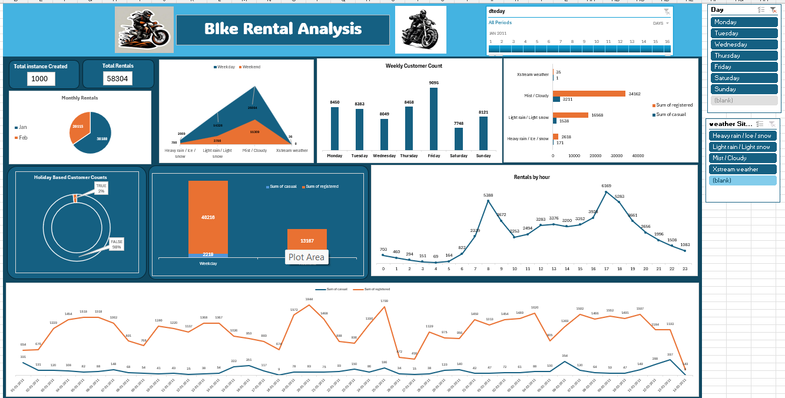
Dashboard

Slide 6
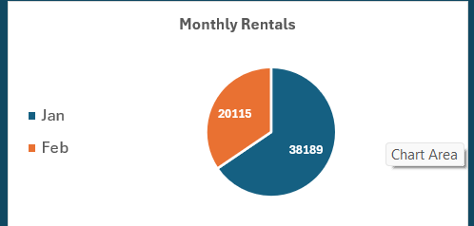
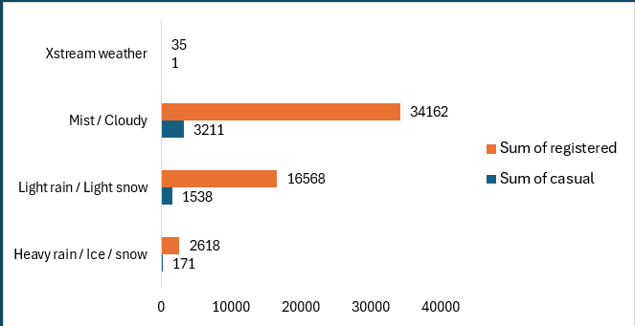
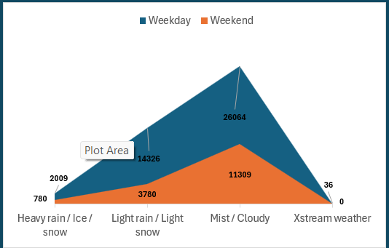
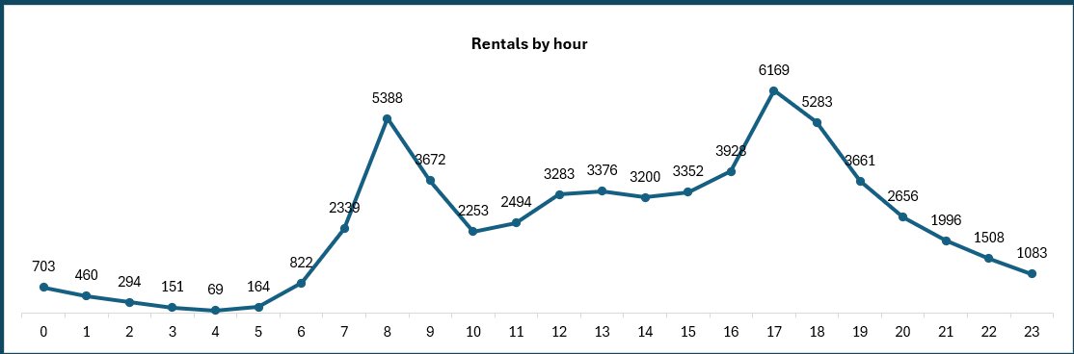
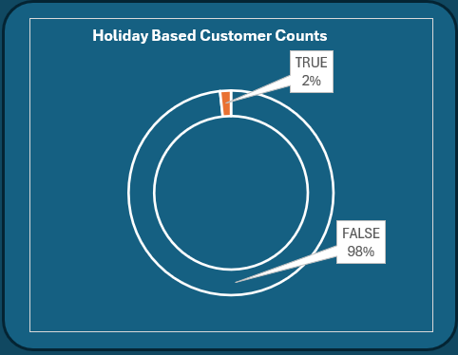
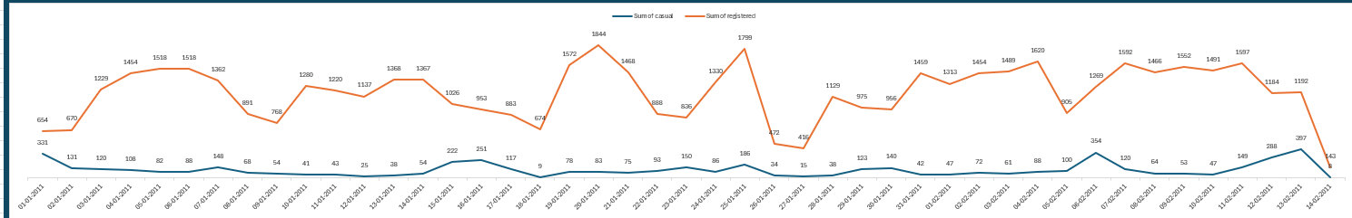
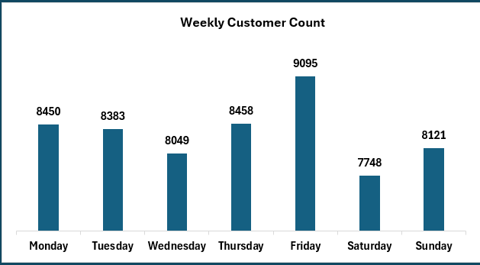
Key Charts Used

Slide 7
Key Insights
Peak Hours Drive Maximum Rentals
Rentals peak around 8 AM and 5–6 PM
Clear office commute pattern
“Bike usage is highest during commute hours, indicating strong dependency on working professionals.”
Registered Users Dominate Demand
Registered users (~40K+) >> Casual (~2–3K)
Huge difference in contribution
“The majority of revenue comes from registered users, showing strong customer retention and subscription usage.”
Weekdays Perform Better Than Weekends
Weekday rentals significantly higher than weekends
“Demand is driven by daily commuting rather than leisure activities.”
Weather Strongly Impacts Rentals
Highest rentals in Clear weather
Sharp drop in: Mist , Rain ,Heavy weather
“Adverse weather conditions significantly reduce bike usage, making weather a key demand driver.”

Slide 8
Key Insights
Friday Has Highest Weekly Demand
Friday shows peak customer count (~9000+)
Saturday lowest
“Demand builds up during weekdays and peaks before the weekend, likely due to office and travel patterns.”
Low Impact of Holidays
Majority rentals happen on non-holidays (~98%)
“Bike rentals are not holiday-driven, reinforcing that usage is primarily work-related.”

Slide 9
Business Recommendations
Registered users drive most – Offer discounted monthly/yearly plans & Loyalty rewards for frequent users
Ensure more bikes at offices , metro stations . Use dynamic rebalancing of bikes
Demand drops in bad weather – Offer discounts during rain/mist .provide rain gear / covered bikes (premium service.)
Weekend demand is low – Launch weekend offers, tourist packages, group ride discounts.
Casual users are very low – offer first time subscription discount.
Demand is commute driven expand near IT parks ,offices , colleges
“Based on the analysis, I would recommend focusing on increasing registered users, optimizing bike availability during peak commute hours, and introducing weather-based and weekend promotions. Additionally, converting casual users into subscribers and expanding near high-demand locations can significantly improve revenue and utilization.”

Slide 10
Learnings & Conclusion
Business problems require multi-dimensional analysis, not just single-variable dependency
Transforming raw data into meaningful features improves analysis quality
Segment-based analysis gives deeper business insights than overall metrics.
Good visualization simplifies complex data into actionable insights.
External/environmental variables play a critical role in user behavior like Weather impacts demand
“Through this project, I learned the importance of feature engineering, user segmentation, and combining multiple factors to derive insights. In the future, this can be extended using machine learning for demand forecasting, dynamic pricing, and location-based optimization to improve business efficiency.”

Slide 11
Thank You !

